Slide 1
Environment Set UP for Android Test Bed
Notes:
Reference:
https://github.com/androidthings/drivers-samples/tree/master/bmx280
https://github.com/androidthings/contrib-drivers/tree/master/bmx280

Slide 2





Set Up Android Test Bed
Host computer
OS: windows 10 pro 64
Memory: 16GB
CPU: Intel® Core™ i5-8500
Guest computer
OS: Ubuntu 18. 04 desktop 64
Memory: 6GB=6144MB
Hard disk: 100GB
Network: bridge
Core: 4
Software: JDK 8, IoTivity 1.3.1, Android Studio
Guest
Host

Slide 3

Environment Network
Internet
Router
Public IP
DHCP Server
Private Network
Bridge
IP: DHCP
HOST
eth0
IP: DHCP
GUEST
VM
Notes:
Gigabytes(GB) 1 = 1000 Magabytes (MB) decimal = 1000 Magabytes (MB) binary

Slide 4
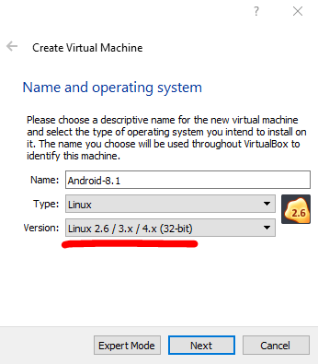
Guest Computer Generation
Guest computer generation
OS: Android x86 8.1
http://www.android-x86.org/
Memory: 4GB=4096MB
Hard disk: 32GB

Slide 5
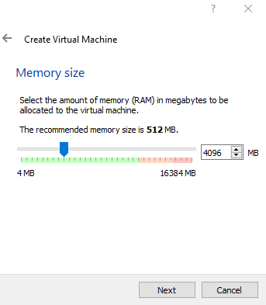
Guest Computer Generation
Guest computer generation
OS: Android x86 8.1
http://www.android-x86.org/
Memory: 4GB=4096MB
Hard disk: 32GB

Slide 6
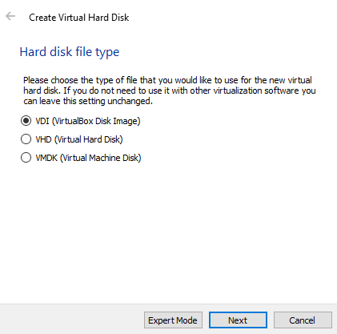
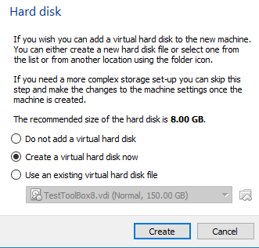
Guest Computer Generation
Guest computer generation
OS: Android x86 8.1
http://www.android-x86.org/
Memory: 4GB=4096MB
Hard disk: 32GB

Slide 7
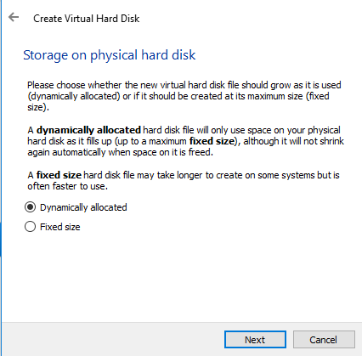
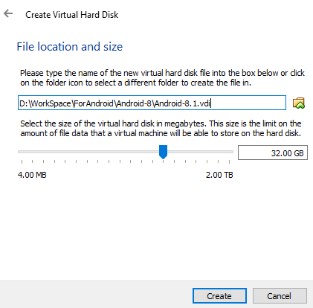
Guest Computer Generation
Guest computer generation
OS: Android x86 8.1
http://www.android-x86.org/
Memory: 4GB=4096MB
Hard disk: 32GB

Slide 8
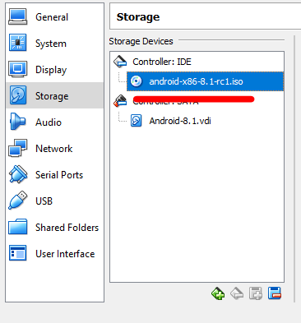
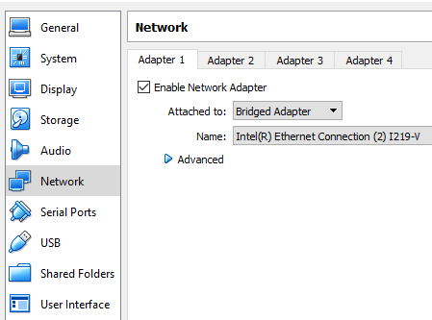
Guest Computer Generation
Guest computer settings
Storage: image selection
Network: bridge

Slide 9
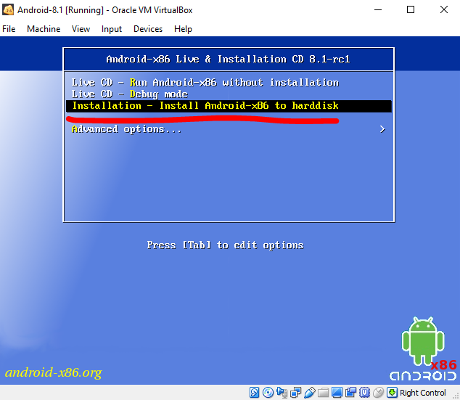
Guest Computer Generation
Install Android
Select installation function

Slide 10
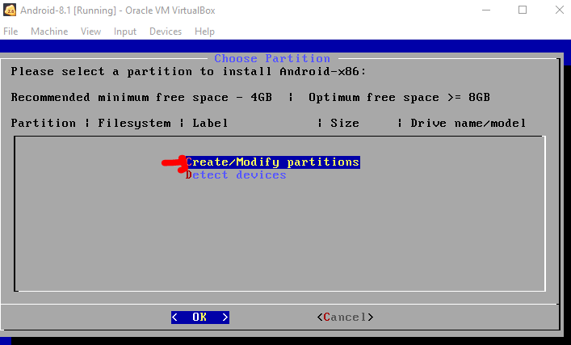
Guest Computer Generation
Install Android
Select installation function
Choose Partition: create/modify partitions

Slide 11
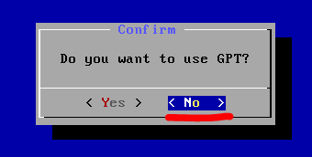
Guest Computer Generation
Install Android
Select installation function
Choose Partition: create/modify partitions

Slide 12
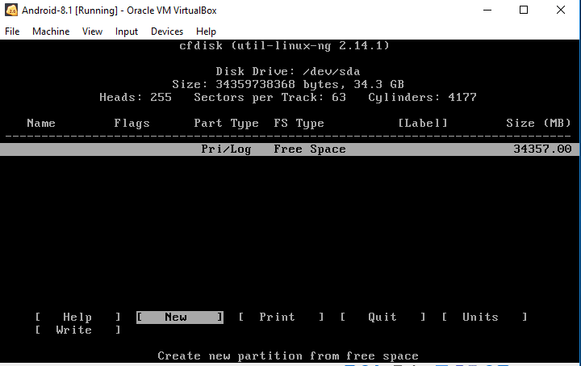
Guest Computer Generation
Install Android
Select installation function
Choose Partition: create/modify partitions
On Disk utility screen: choose new

Slide 13
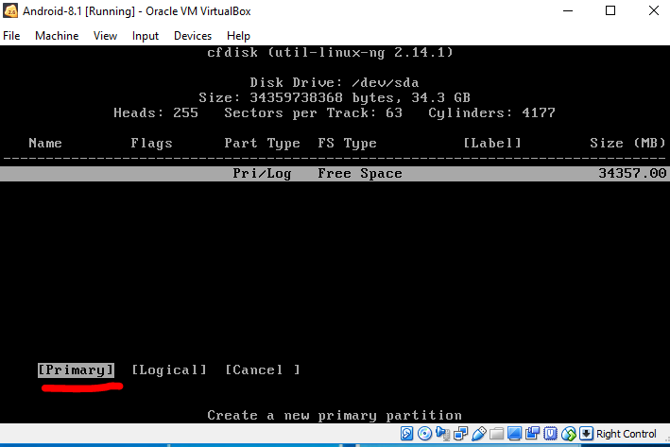
Guest Computer Generation
Install Android
Select installation function
Choose Partition: create/modify partitions
On Disk utility screen: choose new
Create primary disk

Slide 14
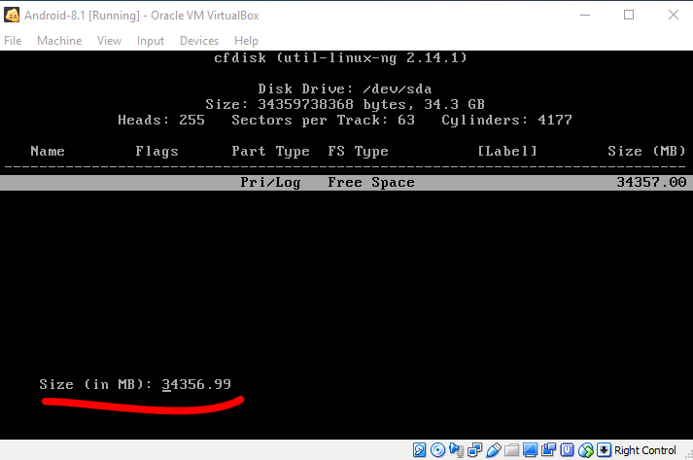
Guest Computer Generation
Install Android
Select installation function
Choose Partition: create/modify partitions
On Disk utility screen: choose new
Create primary disk
Choose all space

Slide 15
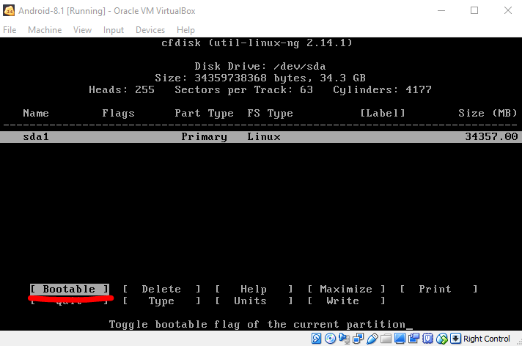
Guest Computer Generation
Install Android
Select installation function
Choose Partition: create/modify partitions
On Disk utility screen: choose new
Create primary disk
Choose all space
Choose Bootable

Slide 16
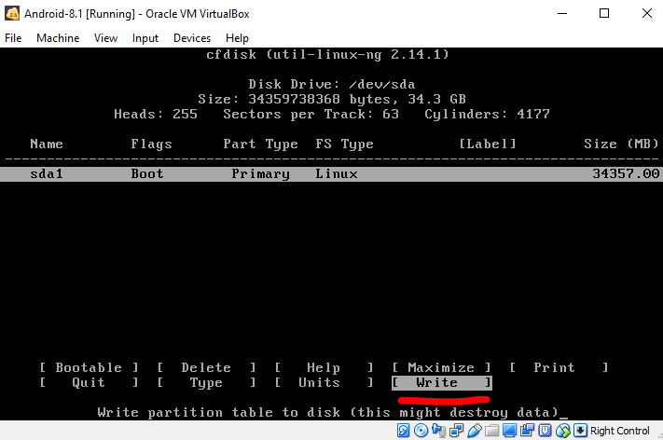
Guest Computer Generation
Install Android
Select installation function
Choose Partition: create/modify partitions
On Disk utility screen: choose new
Create primary disk
Choose all space
Choose Bootable
Choose Write

Slide 17
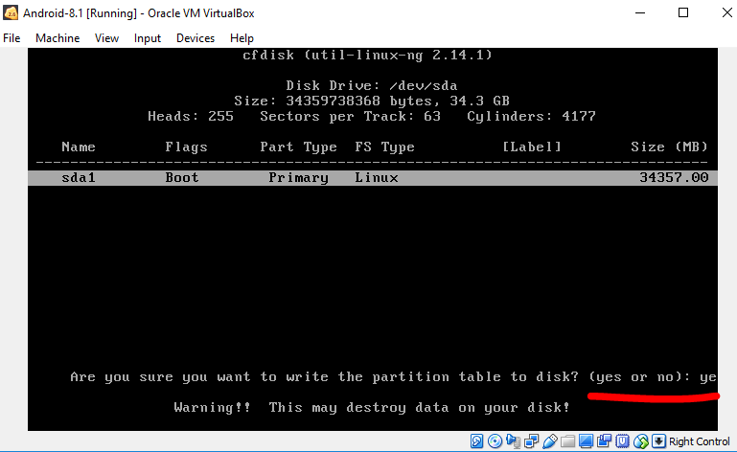
Guest Computer Generation
Install Android
Select installation function
Choose Partition: create/modify partitions
On Disk utility screen: choose new
Create primary disk
Choose all space
Choose Bootable
Choose Write : set yes

Slide 18
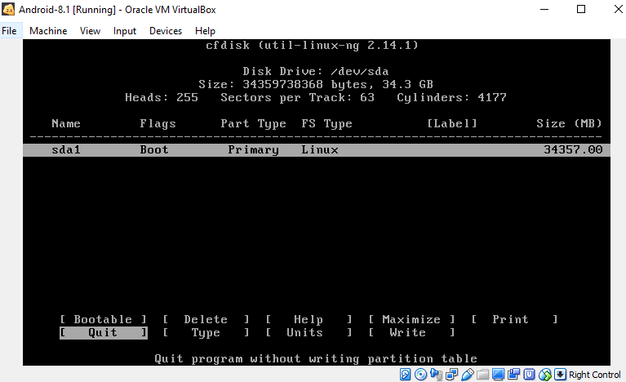
Guest Computer Generation
Install Android
Select installation function
Choose Partition: create/modify partitions
On Disk utility screen: choose new
Create primary disk
Choose all space
Choose Bootable
Choose Write : set yes
Choose Quit

Slide 19
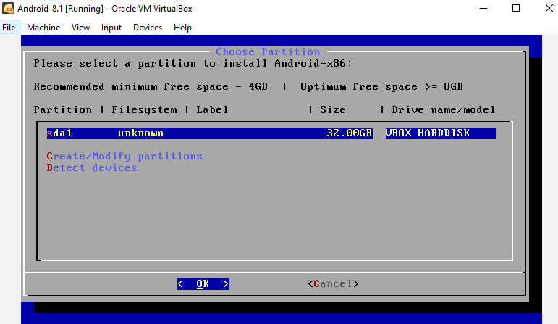
Guest Computer Generation
Install Android
Select installation function
Choose Partition: create/modify partitions
On Disk utility screen: choose new
Create primary disk
Select partition that just created

Slide 20
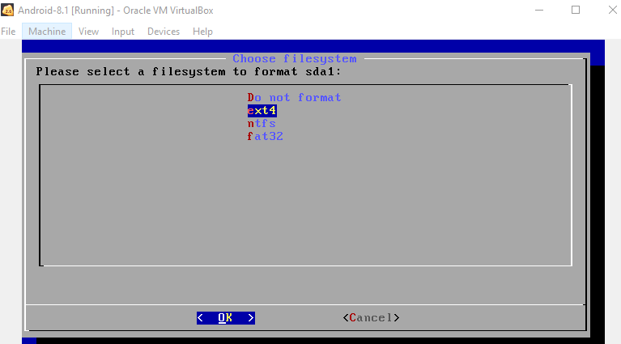
Guest Computer Generation
Install Android
Select installation function
Choose Partition: create/modify partitions
On Disk utility screen: choose new
Create primary disk
Select partition that just created
Select format ext4

Slide 21
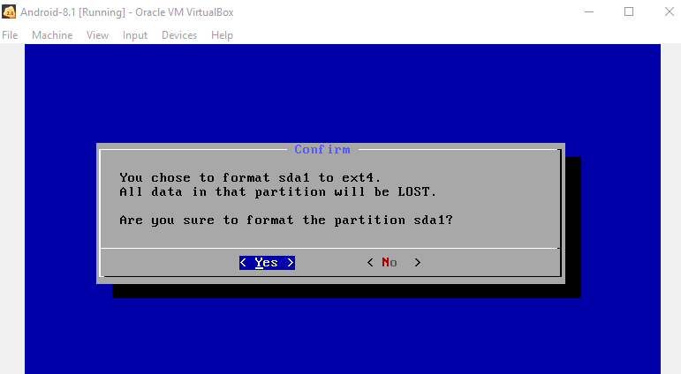
Guest Computer Generation
Install Android
Select installation function
Choose Partition: create/modify partitions
On Disk utility screen: choose new
Create primary disk
Select partition that just created
Select format ext4

Slide 22
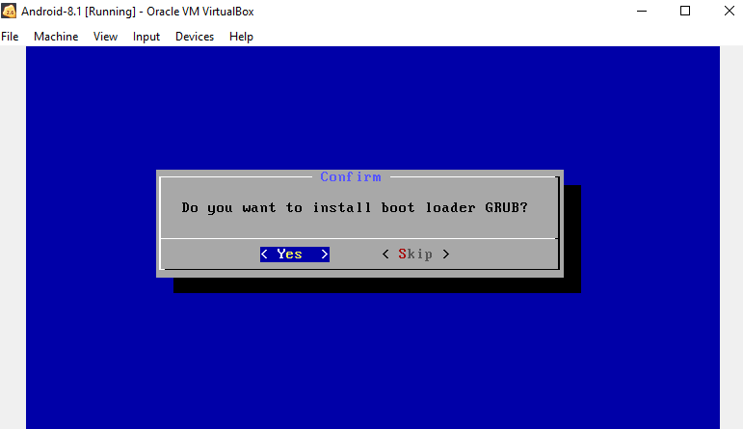
Guest Computer Generation
Install Android
Select installation function
Choose Partition: create/modify partitions
On Disk utility screen: choose new
Create primary disk
Select partition that just created
Select format ext4
Choose yes to boot loader GRUB

Slide 23
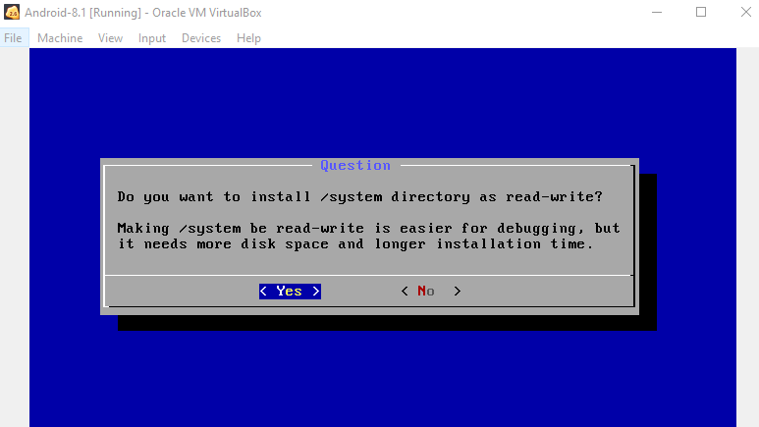
Guest Computer Generation
Install Android
Select installation function
Choose Partition: create/modify partitions
On Disk utility screen: choose new
Create primary disk
Select partition that just created
Select format ext4
Choose yes to boot loader GRUB
Choose system read write

Slide 24
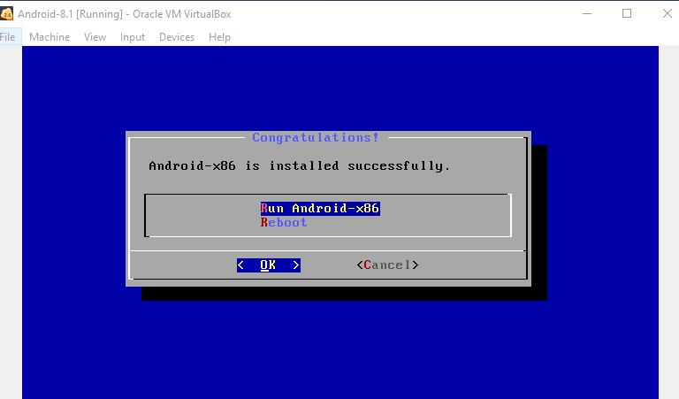
Guest Computer Generation
Install Android
Select installation function
Choose Partition: create/modify partitions
Successfully

Slide 25
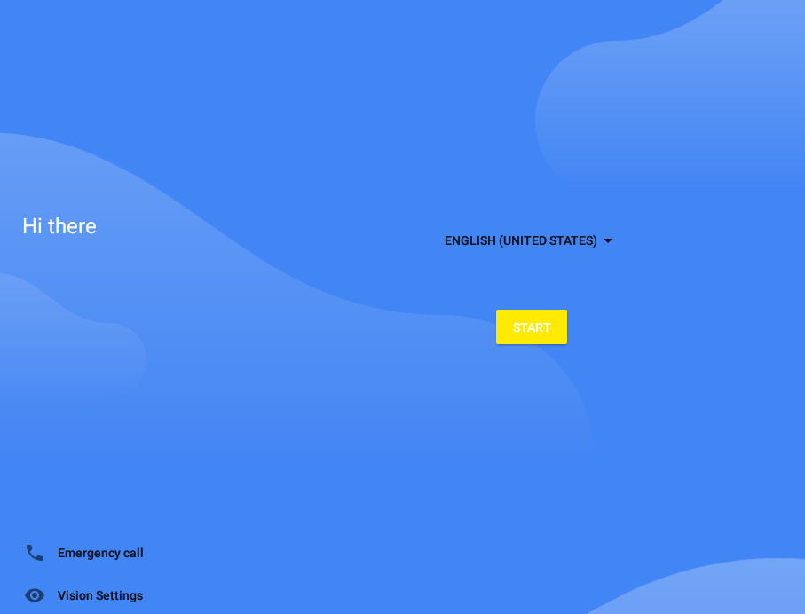
Guest Computer Generation
Install Android
Select installation function
Choose Partition: create/modify partitions
Successfully

Slide 26
Reference
https://www.howtogeek.com/164570/how-to-install-android-in-virtualbox/
https://www.howtogeek.com/213795/how-to-enable-intel-vt-x-in-your-computers-bios-or-uefi-firmware/

